Slide 1
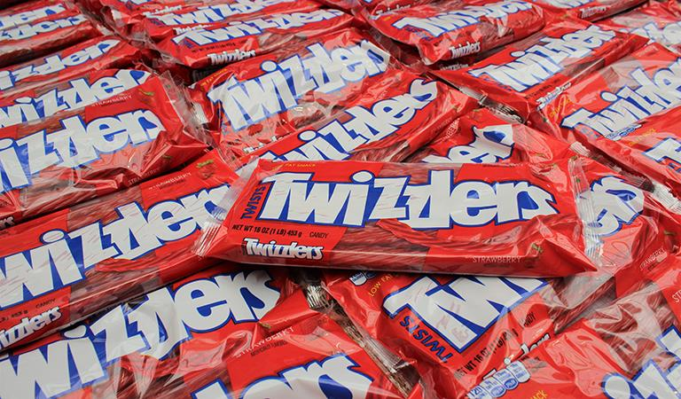

LEMON LIME TWIZZLERS
LAUNCH ANALYSIS
GROUP 5: JENNA GAMBINO, Abhyas Ramadugu, X

Slide 2



AGENDA
02
03
01
02
03
PROJECT OVERVIEW
PRE-LAUNCH ANALYSIS
PRE-LAUNCH INSIGHTS
04
05
04
05
POST-CAMPAIGN ANALYSIS
POST-CAMPAIGN INSIGHTS
Team Introductions, Purpose & Goals
Analysis to identify market and opportunities
Recommendations based on pre-launch analysis
Campaign performance & key learnings
Details discovered, recommendations moving forward

Slide 3
01
PROJECT OVERVIEW

Slide 4
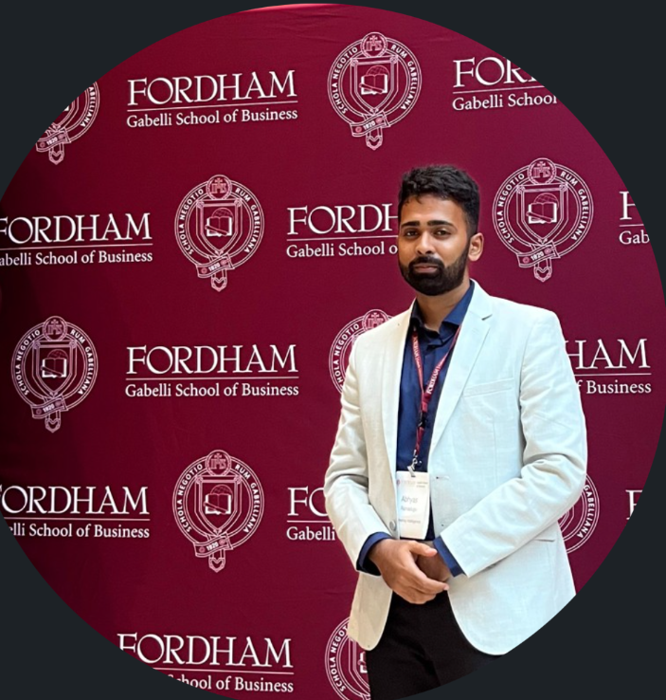



YOUR PROJECT TEAM
NEPTUNE
JENNA GAMBINO
ABHYAS
RAMADUGU
NITIN
CHHIKARA
Neptune is the farthest planet from the Sun, the fourth-largest in our Solar System and also the densest

Slide 5
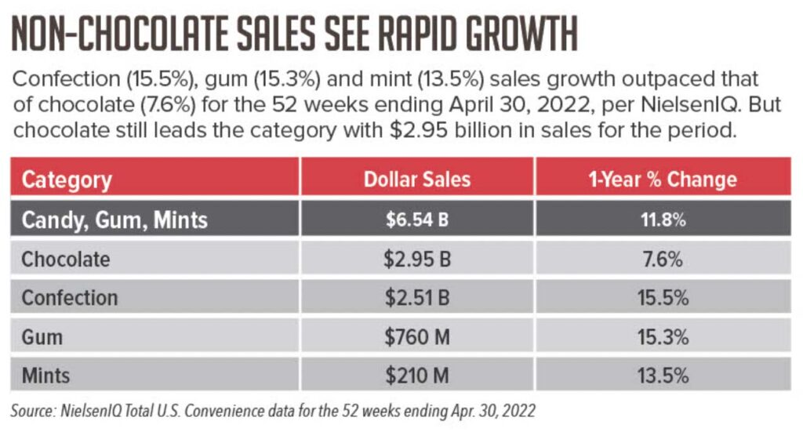
THE WHY
There has been a marked uptick in both demand and consumption of candy and fast-snack products as a result of the pandemic and post-pandemic buying behavior. Based on this, it was hypothesized that launching a new product (Lemon Lime Filled Twizzlers) may prove successful for Hershey overall. Through analysis of both survey and behavioral data pre-launch, as well as data post-campaign, we will determine the success of the launch and recommendations moving forward.
Notes:
Candy sales are projected to increase 4% to 6% during the next few years. The faster growing non-chocolate category is expected to expand between 6% and 7%, while chocolate sales go from 3% to 5%, according to a research report from Kalorama Research LLC.

Slide 6
THE PROCESS
RECOMMEND LAUNCH MIX
KEY LEARNINGS
DETERMINE TARGET
MEASURING SUCCESS
Recommendation of ad spend areas / launch media mix based on target market
Key campaign learnings and recommendations moving forward
Utilize data from pre-launch surveys to determine target market and understand their behaviors
Analysis of post-campaign data to understand sales lift, progress against success metrics (CTR, CPC, TSAR< CPTSA)

Slide 7
02
PRE-LAUNCH
ANALYSIS

Slide 8
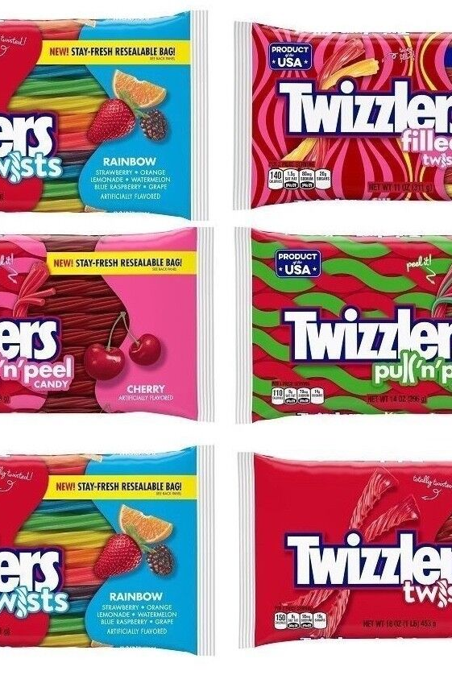
PRE-LAUNCH
ANALYSIS
GOALS
Determine if Lemon Lime Filled Twizzlers will be of interest, based on panel survey data + behavioral data
Determine brand lift based on product messaging exposure
Utilize lift metrics to hone-in on target market
Analyze behavioral data among target to recommend launch media mix

Slide 9
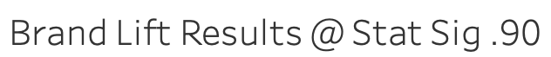
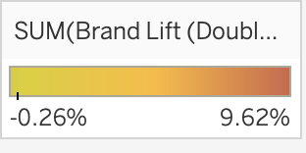
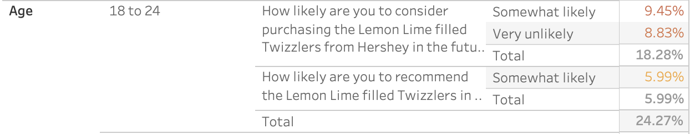
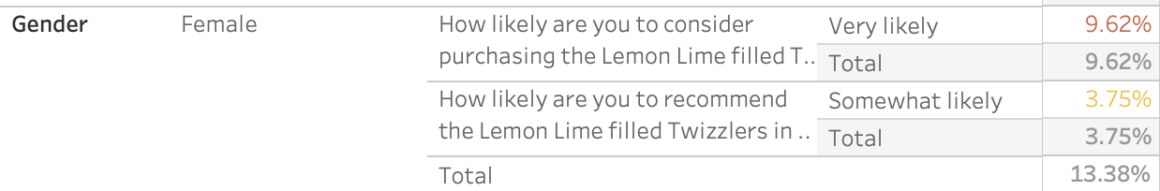
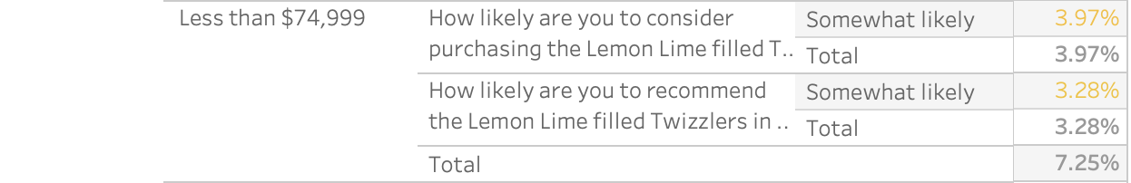
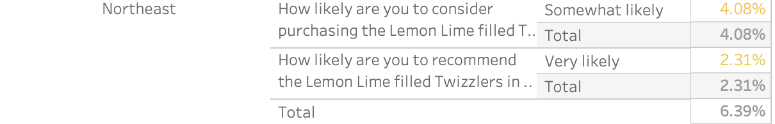
PRE-LAUNCH DATA
LIFT = EXPOSED - CONTROL
ANALYSIS
Overall brand lift of 88% at Stat Sig .90 as a result of exposure.
Greatest lift was among:
Ages 18-24
Females
HHI less than $74,999 yearly
Northeast region
Likely college-age, or newly undergrad (graduated) females in the Northeast
More inclined to buy candy due to taste preferences* or due to budget
*https://www.chiefmarketer.com/candy-lovers/
Notes:
SOME 75% of adults regularly buy or eat candy. Those with the biggest sweet tooth are 18- to 24-year-olds living in households with five or more people with or without children, according to Simmons Market Research Bureau.

Slide 10
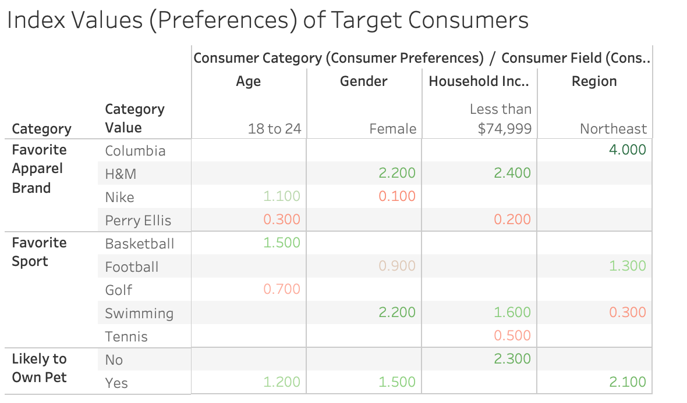
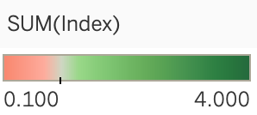
PRE-LAUNCH BEHAVIORAL INDEX
KEY:
Index values of 1 denotes neither like or dislike
Index values above 1 denotes strong preference
Index value below 1 denotes lower preference
Notes:
Based on the index values, or preferences of our specified target consumer (based on surveys) it is evident that we should focus on the below.
To reach our target audience of 18-24 year old females, with average HHI less than $74,999 living within the Northeast, we would suggest the following strategies:
- Target individuals with digital advertising who have visited websites such as Chewy.com, or those who have recently made pet-related online purchases as 18-24 year old Females in the Northeast most likely to purchase Lemon Lime filled Twizzlers, are more likely to own a pet.
- Advertise in partnership with USA Swimming or a well-known swimming brand or influencer in order to reach females with HHI less than $74,999 (Indexing 2.2 and 1.6 above average, respectively) or advertise during NBA games to reach 18-24 year olds (indexing 1.5 above average)
- Moreover, both females and those with HHI less than $74,999 are more likely to shop at H&M (indexing at 2.2 and 2.4, respectively) therefore, perhaps partner with the retailer to host high-impact ads on their sites, or offer product available for purchase at select H&M Stores.
-While those in the Northeast very much prefer Columbia as their favorite apparel brand (indexing at 4.0) it may not be worth partnership spend as all other target market categories do not prefer this brand whatsoever, but perhaps it makes sense to target people who have visited the Columbia site, shopped the brand, or follow their social media channel to get served these ads as a continued awareness play.

Slide 11
03
PRE-LAUNCH
INSIGHTS

Slide 12

RECOMMENDED MEDIA MIX
DIGITAL DISPLAY & RETARGETING
SEARCH
SOCIAL MEDIA & HIGH IMPACT
DIsplay Lemon Lime Filled Twizzler ads programmatically across various sites, utilizing geo-fencing, interest and behavioral targeting. Retarget those who have visited the site, or have seen/interacted with an ad elsewhere.
Buy against specific search keywords to maximize awareness and interactions as well as optimize chances of consideration
Connect with digital-native target audience through advertising on various social platforms.
Launch High-Impact ad formats with specified partners

Slide 13
04
POST-CAMPAIGN
ANALYSIS

Slide 14
KPI Performance Nov 22 - Jan 23
Trended Upwards
Week 1: $1.21
Week 13: $3.85
Remained Stable
Week 1: 0.3%
Week 13: 0.4%
Trended Downwards
Week 1: $4.25
Week 13: $3.20
$2.64
0.4%
$3.80
CPC
TSAR
ROAS
0.5%
$3.20
CTR
CPTSA
Trended Downwards
Week 1: 0.8%
Week 13: 0.5%
Trended Upwards
Week 1: $3.02
Week 13: $4.09

Slide 15
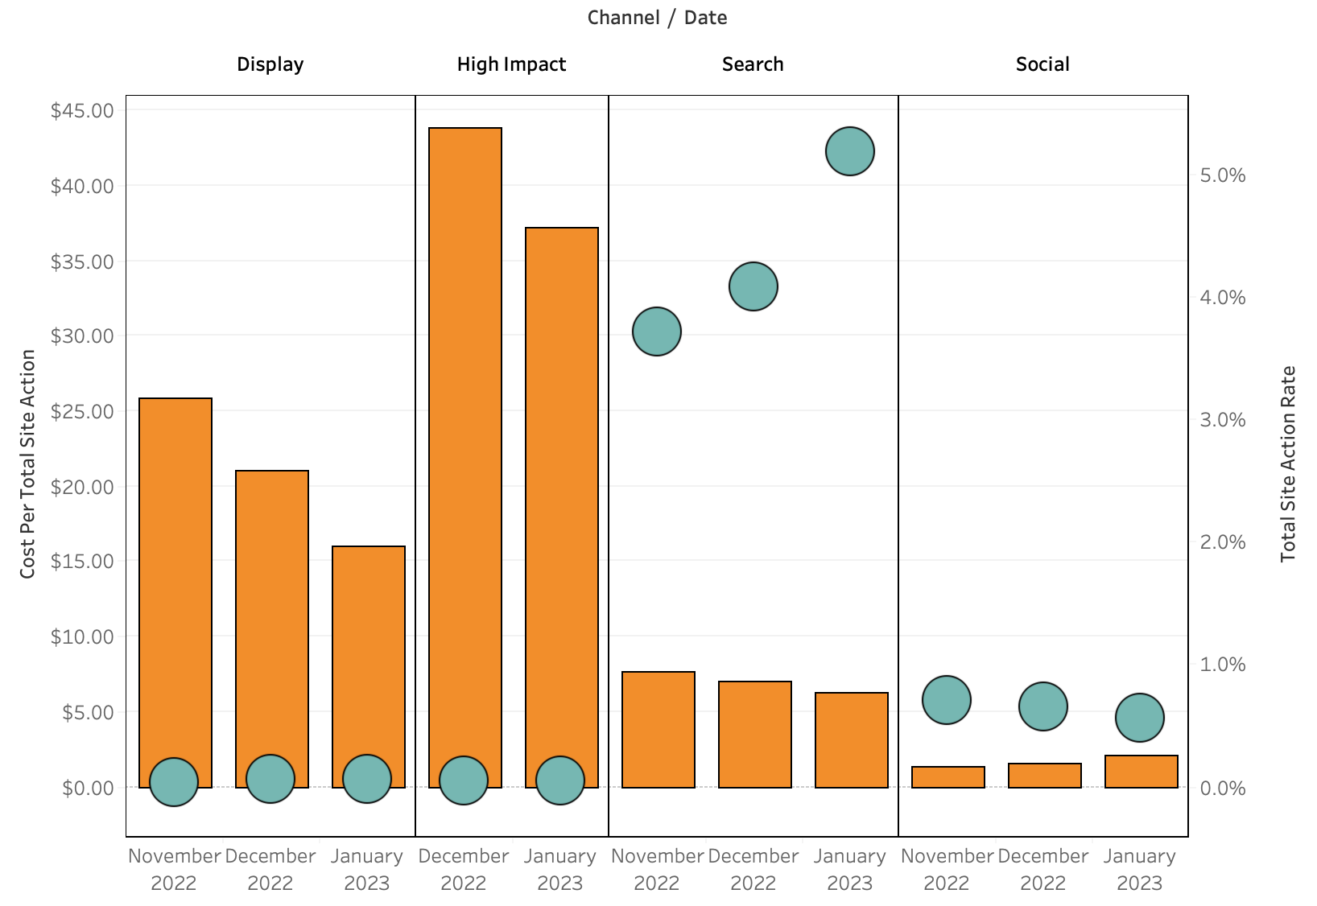
KPIs BY CHANNEL
KEY:
CPTSA is highest for High Impact ads followed by Display ads both of which resulted in the lowest CTR
CPTSA is the relatively low for Search ads when those provide the best CTR by far
Our recommendation would be to increase the spend on Search ads which will provide more meaningful results to the campaign which reducing the spend on High Impact and Display ads

Slide 16
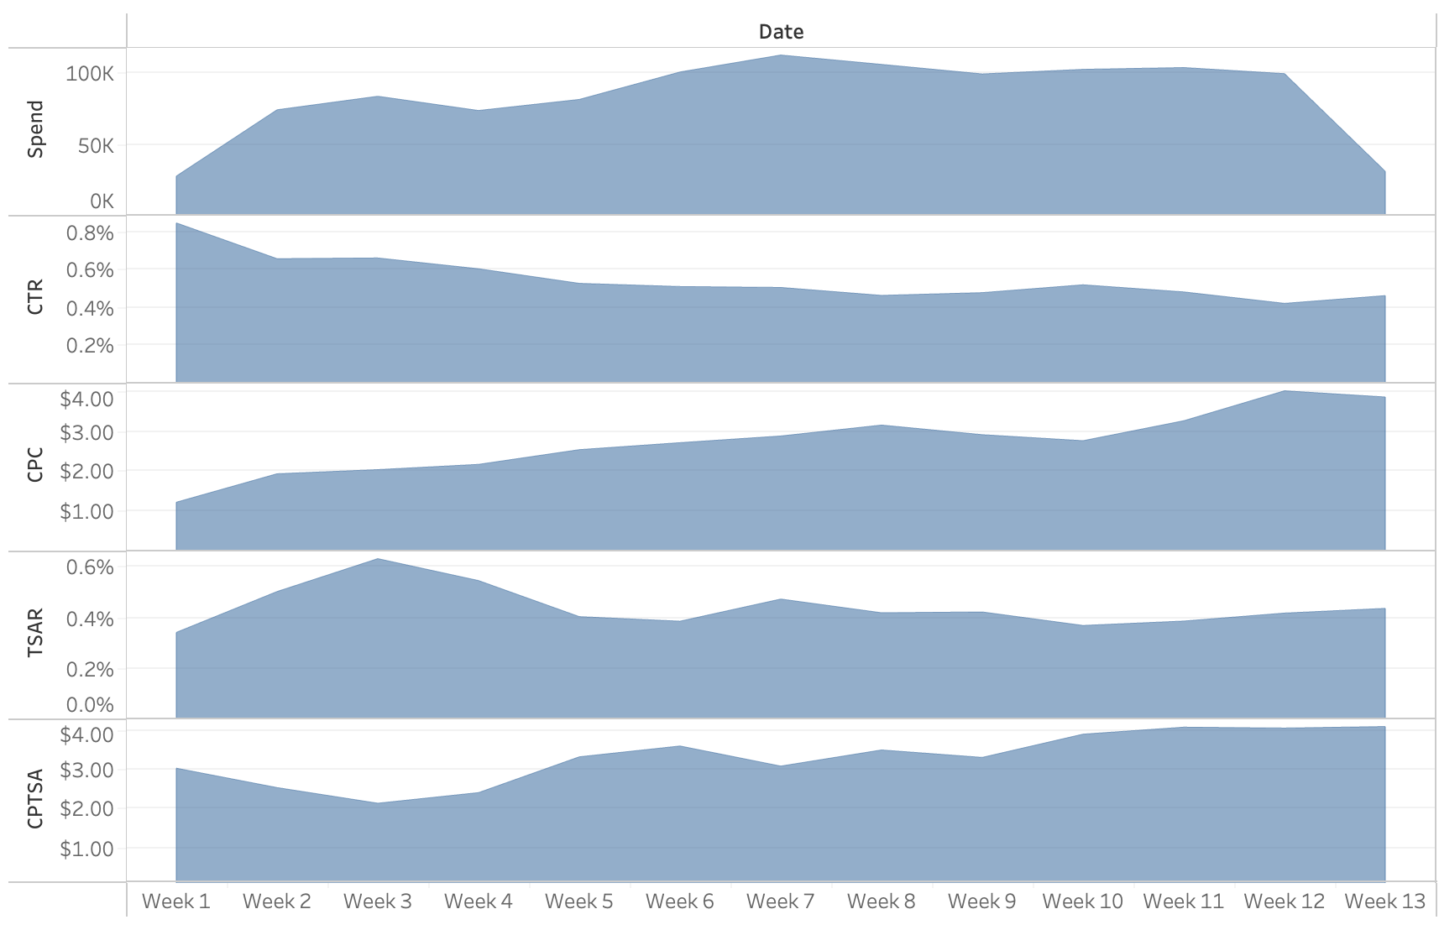
KPIs vs SPEND
KEY:
In this campaign spend is inversely related to CTR. As the initial spend increases CTR nearly halves from the beginning baseline figure and starts to increase as spend tails off towards the end
TSAR is directly related to spend as it flatlines regardless of increase or decrease in spend
Also as the spend for campaign increases CPC and CPTSA also start to increase
Notes:
Based on the index values, or preferences of our specified target consumer (based on surveys) it is evident that we should focus on the below.
To reach our target audience of 18-24 year old females, with average HHI less than $74,999 living within the Northeast, we would suggest the following strategies:
- Target individuals with digital advertising who have visited websites such as Chewy.com, or those who have recently made pet-related online purchases as 18-24 year old Females in the Northeast most likely to purchase Lemon Lime filled Twizzlers, are more likely to own a pet.
- Advertise in partnership with USA Swimming or a well-known swimming brand or influencer in order to reach females with HHI less than $74,999 (Indexing 2.2 and 1.6 above average, respectively) or advertise during NBA games to reach 18-24 year olds (indexing 1.5 above average)
- Moreover, both females and those with HHI less than $74,999 are more likely to shop at H&M (indexing at 2.2 and 2.4, respectively) therefore, perhaps partner with the retailer to host high-impact ads on their sites, or offer product available for purchase at select H&M Stores.
-While those in the Northeast very much prefer Columbia as their favorite apparel brand (indexing at 4.0) it may not be worth partnership spend as all other target market categories do not prefer this brand whatsoever, but perhaps it makes sense to target people who have visited the Columbia site, shopped the brand, or follow their social media channel to get served these ads as a continued awareness play.

Slide 17
CURRENT VS PREVIOUS CAMPAIGN
CPC
CPTSA
CTR
TSAR
ROAS
SALES
CPC
CPTSA
CTR
TSAR
ROAS
SALES
DETERMINE TARGET
$6.52
$0.79
0.9%
7.4%
$2.86
$84,085
$2.64
$3.20
0.5%
0.4%
$3.80
$1,751,652
Utilize data from pre-launch surveys to determine target market and understand their behaviors
Every metric except CPC performed worse than the previous campaign.
Total amount of sales grew when compared with previous campaign sales.
Based on the numbers we can say the Campaign was a “success” because we reduced the cost by 40% and at same time increasing the sales amount by 20x.
Also we suggest moving forward, Metrics other than CPC and Sales should be given less importance in measuring the success of future campaigns.

Slide 18
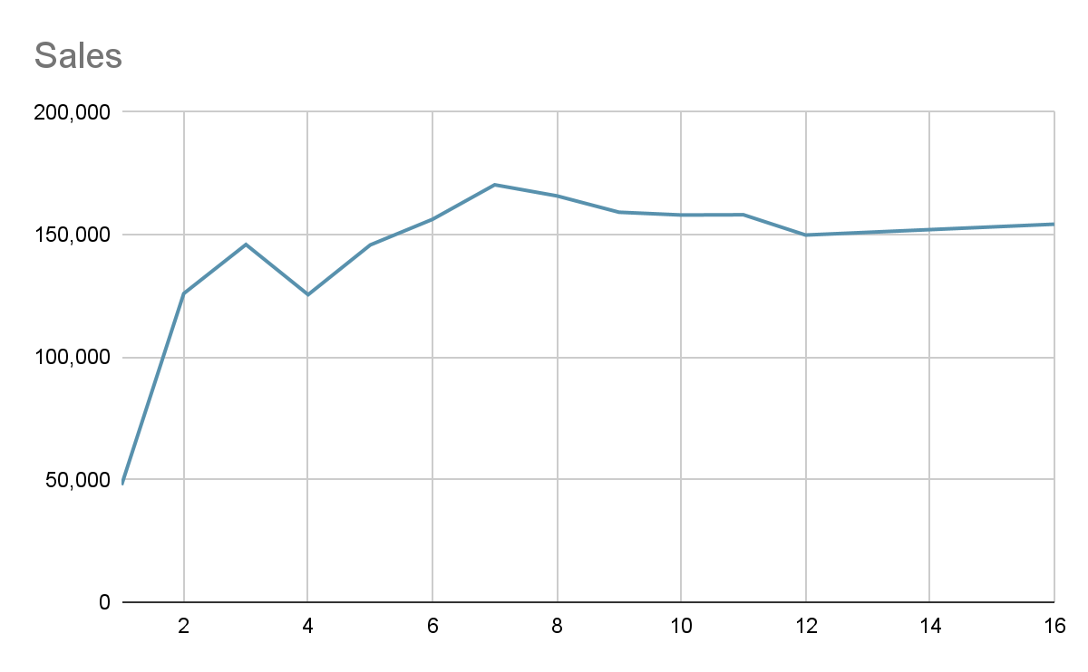
PREDICTIVE
ANALYSIS
Based on our predictive analysis
Sales For Next 2 weeks: $152,055
Sales For Next Month: $154, 270

Slide 19
05
POST-CAMPAIGN
INSIGHTS

Slide 20






How did our Partners do?
1280px-Google_2015_logo.svg.png
Poor
Scope for Improvement
Best
Ranked 2nd in engagement
Sales can be improved
Utilize this channel to drive sales from distributor network
Focus more on the target profile, work with Google to improve targeted advertising
Expensive High Impact Ads (Only)
Lowest Sales
Can shift focus towards print media from online content
Collaborate with swimming and basketball athletes.
No specific recommendations
Top performers
E-commerce giant, more sales can be expected
CPC/CPTSA costs can be lowered
Run ads on social and search channels
Target customer is likely to own a pet, shopping recommendations can be tailored.
Target customer is most likely not watching this channel.
Highly expensive, can focus more on the tech product review website or entertainment section of CNN

Slide 21
THANKS
Q&A

